Slide 1


IOT-BASED VEHICLE NUMBER PLATE DETECTION SYSTEM
A PROJECT REPORT
Submitted by
- 412623106006
M. GANESH
P. KARPAGASELVI - 412623106011
B. ABIMANYU - 412623106001
BACHELOR OF ENGINEERING
IN
ELECTRONICS AND COMMUNICATION ENGINEERING
SRI VENKATESWARAA COLLEGE OF TECHNOLOGY (AUTONOMOUS)
Vadakal Village, BHB Nagar, Oragadam Industrial Corridor Sriperumbudur – 602 105
ANNA UNIVERSITY: CHENNAI – 600 025
Academic year 2023 - 2027

Slide 2
Abstract
Vehicle Number Plate Detection is an important application of computer vision and image processing that aims to automatically identify and extract vehicle registration numbers from images or video streams. This project focuses on developing an efficient and reliable system using Python, OpenCV, and Easy OCR to detect and recognize number plates in real-time scenarios. The system begins by capturing an image through a camera or loading an input image, followed by preprocessing techniques such as grayscale conversion, noise reduction, and thresholding to enhance image quality. Next, the number plate region is detected using contour detection or object detection methods, ensuring accurate localization even under varying lighting conditions. Once the plate area is identified, Optical Character Recognition (OCR) is applied to extract the alphanumeric characters present on the plate. The extracted text is then processed and cleaned to remove unwanted symbols and improve readability. This project has significant real-world applications including traffic monitoring, automated toll collection, parking management systems, and law enforcement for identifying stolen vehicles. The system is designed to be scalable and can be further enhanced by integrating machine learning algorithms to improve detection accuracy and adaptability. In conclusion, this project demonstrates how image processing and OCR technologies can be combined to build an automated and intelligent vehicle identification system, reducing manual effort and increasing efficiency int ransportation management systems.

Slide 3
Introduction :
Vehicle Number Plate Detection is an advanced application of computer vision.
It helps in automatically identifying vehicle registration numbers.
Traditional methods involve manual checking, which is slow and error-prone.
This project replaces manual work with an automated solution.
It uses image processing techniques to locate number plates.
OCR technology is used to read characters from the plate.
This system is useful in many real-time applications like traffic monitoring.
Objective :
The main objective is to build an automated number plate detection system.
It aims to reduce human effort in vehicle identification.
The system captures images from a camera or dataset.
It detects the number plate region accurately.
OCR is used to extract alphanumeric characters.
Preprocessing techniques are applied to improve accuracy.
Overall, the goal is to create a fast and reliable system.

Slide 4
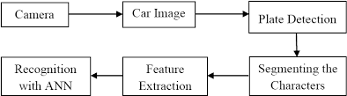
PROBLEM STATEMENT :
Manual vehicle monitoring is time-consuming and inefficient.
Human errors may occur while reading number plates, In crowded areas, tracking vehicles becomes difficult, There is a need for an automated and accurate solution, Existing systems may fail under poor lighting conditions, Security systems require fast vehicle identification,
Hence, this project solves these problems using automation.
TECHNOLOGY USED ;
Python is used as the main programming language. OpenCV is used for image processing operations.
OCR is used to recognize text from images.Easy OCR engine helps extract characters.
NumPy is used for handling image data.
The system runs on a simple computer setup.
These technologies make the system efficient and scalable.

Slide 5
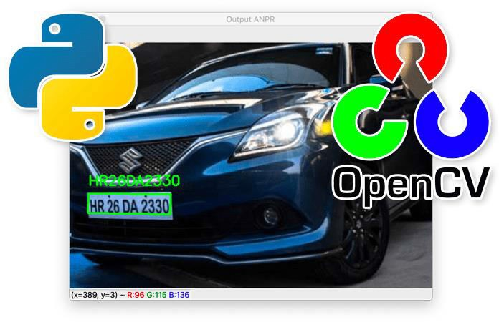
SYSTEM ARCHITECTURE ;
The system starts by taking an input image or video.
The image is preprocessed to improve quality.
The number plate region is detected using algorithms. The detected region is cropped from the image.
OCR is applied to extract text from the plate.
The extracted text is cleaned and formatted.
Finally, the output is displayed or stored in a database.
IMAGE PROCESSING ;
Image processing is used to enhance image quality.
The image is converted into grayscale format. Noise is reduced using filters like Gaussian blur. Thresholding is applied to highlight characters. Edges are detected to locate important regions. These steps improve detection accuracy.
Proper preprocessing is essential for better OCR results.

Slide 6
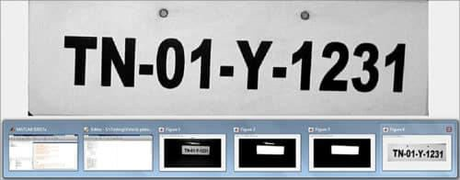
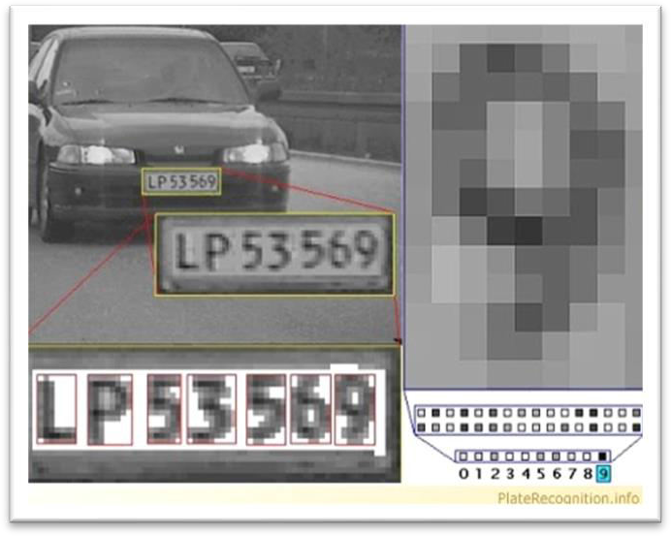
PLATE DETECTION :
Plate detection identifies the number plate region.
Contours are used to detect rectangular shapes. The system filters regions based on size and shape. Only the number plate region is selected.
Accurate detection is important for OCR success.
Different lighting conditions are handled carefully. This step ensures correct region extraction.
OCR RECOGNITION :
OCR stands for Optical Character Recognition.
It converts image text into machine-readable text. Tesseract OCR is used in this project.
The cropped plate image is given as input.
Characters are detected and converted into text. Output may contain noise, so cleaning is required. Finally, the correct vehicle number is displayed.

Slide 7
APPLICATION :
This system is used in traffic monitoring systems. It helps in automatic toll collection.
Parking management systems use this technology.
It is useful in security and surveillance. Police can track stolen vehicles easily.
It reduces manual checking in checkpoints.
Overall, it improves efficiency in transportation systems.
CONCULSION & FUTURE SCOPE :
This project successfully detects and recognizes number plates.
It reduces manual work and increases efficiency. The system works well with clear images.
Accuracy can be improved with better models. Future scope includes real-time video processing.
Cloud and mobile integration can be added.
This project has strong potential in smart city applications.

Slide 8
THANK YOU

